Slide 1
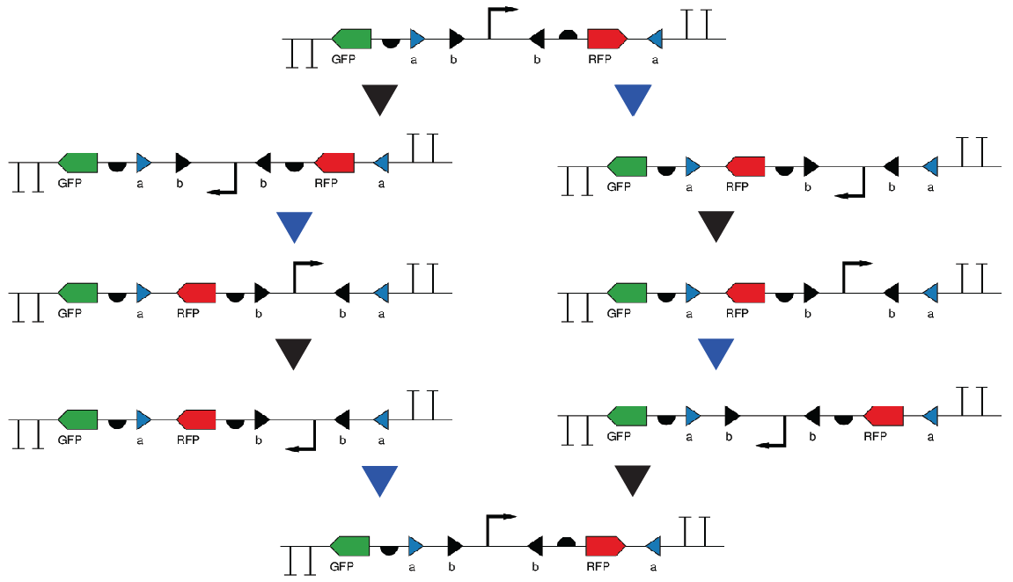


4 State Memory Circuit
Fluorescence
Fluorescence
A Site
B Site
Notes:
Simple 4 state memory circuit. Rewritable memory

Slide 2
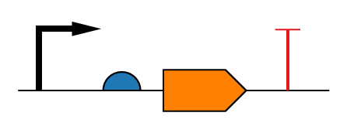

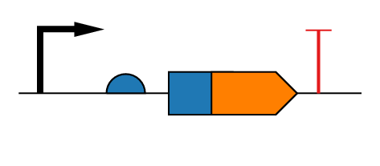
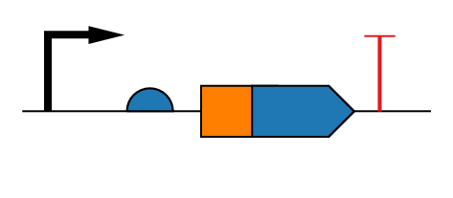
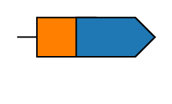
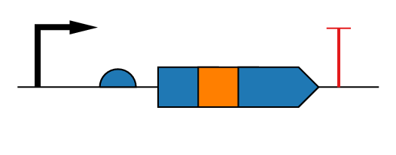
Fusion Protein Generation
Standard MoClo Reaction
A
B
B
C
C
D
D
E
prom
rbs
cre
term
prom rbs cre term
Fusion MoClo Reactions
A
B
B
C
C
X
X
D
D
E
prom
rbs
reg-N
cre
term
prom rbs reg-N:cre term
A
B
B
C
C
Y
Y
D
D
E
prom
rbs
cre
reg-C
term
prom rbs cre:reg-C term
A
B
B
C
C
X
X
Y
Y
D
D
E
prom
rbs
reg-N
cre
reg-C
term
prom rbs reg-N:cre:reg-C term
Notes:
My fusion protein scheme in MoClo

Slide 3
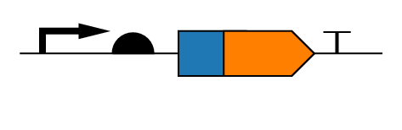

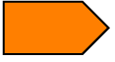
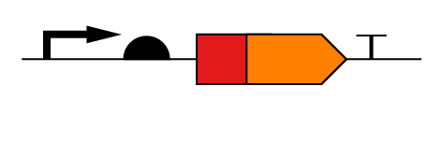
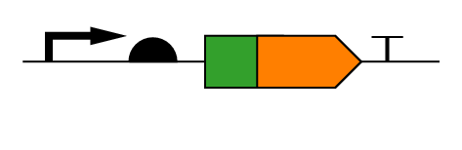
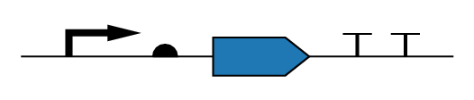
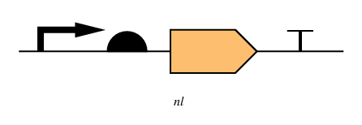
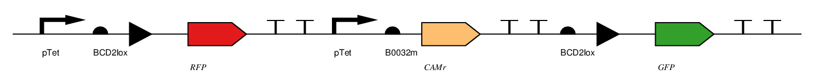
EOS S13: MMC Fusion Library Screen
L1 MMC
A
LacZα
E
A
E
Base state: RFP + growth on CAM/KAN Blue CFU with IPTG/X-gal
Inactive cre: RFP + growth on CAM/KAN White CFU with IPTG/X-gal
Kan^{R}
Kan^{R}
Library screen specifically for Cre fusion proteins. The variable domain can be either before or after the “orange” cre or on both sides.
A
E
Active cre: GFP + growth on KAN only White CFU with IPTG/X-gal
Kan^{R}
Notes:
Reporter cassette = J23106:BCD2lox:E1010m:B0015:J23100:B0032m:J31005:B0015:BCD2lox:E0040m:B0015 before excision, J23106:BCD2lox:E0040m:B0015 after excision.

Slide 4
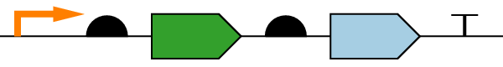
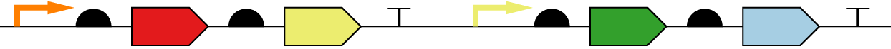
Multiplex Modular Assembly and Screening
One pot
If GOI = repressor
Expected Transfer Function
LBD:GOI
GFP
Cam^{R}
Antibiotic selection for inactive GOI
[GFP]
Kan^{R}
[Ligand]
If GOI = inducer
Select for inducibility by FACS
RFP
tetR
GFP
Cam^{R}
[GFP]
[RFP]
Antibiotic selection for inactive GOI
LBD:GOI
Kan^{R}
[Ligand]
Notes:
Similar fusion protein screen for engineering synthetic allosteric control transcription factors.

